Slide 1
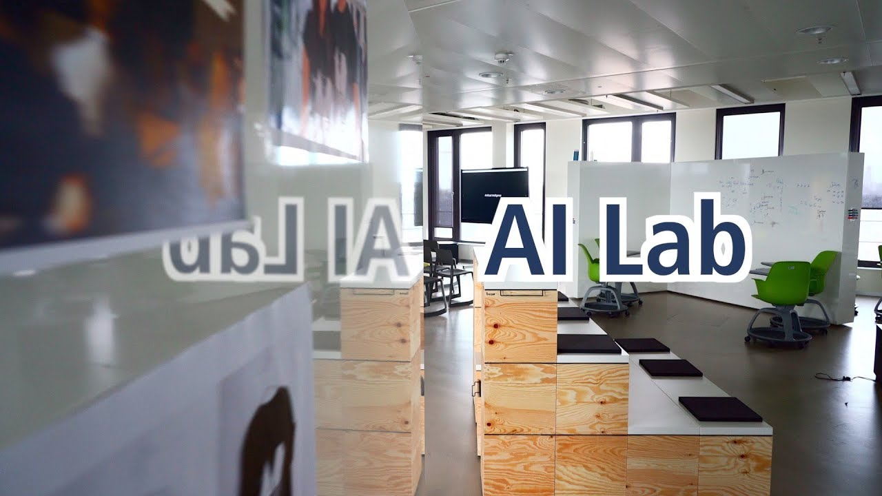
NYANZI MATIA
PRESENTER
0706806111
0781260856

Slide 2
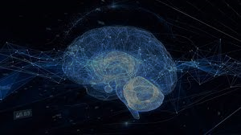
Artificial Intelligence
Is the ability of a computer to do what human beings can do
Types Of Artificial Intelligence
Weak AI – google assistant , siri , beacondoctor App , alexa
Strong AI – self driving cars
Super intelligent – not yet there , expect in movies

Slide 3

OUR INSPIRATION
Job Opportunities
Hardships in doing course works and research work
Nearing exhibition for national council
Increased usage of smart phones
Need to strengthen relationships with those outside campus
etc

Slide 4

What shall we cover ?
Machine learning like predicting your next CGPA of this semester
Deep learning like image processing
Natural language processing like simple robot program
Data analysis like extracting useful patterns in dataset
etc

Slide 5
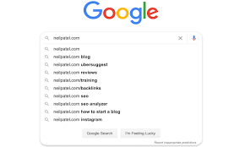

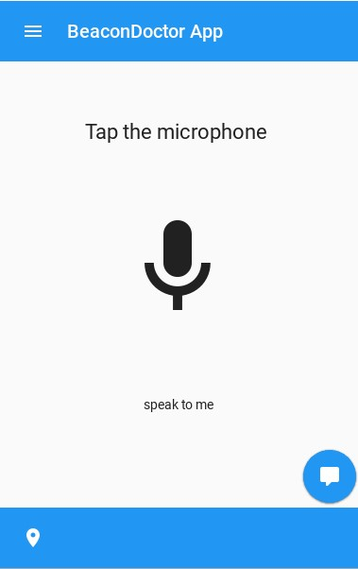

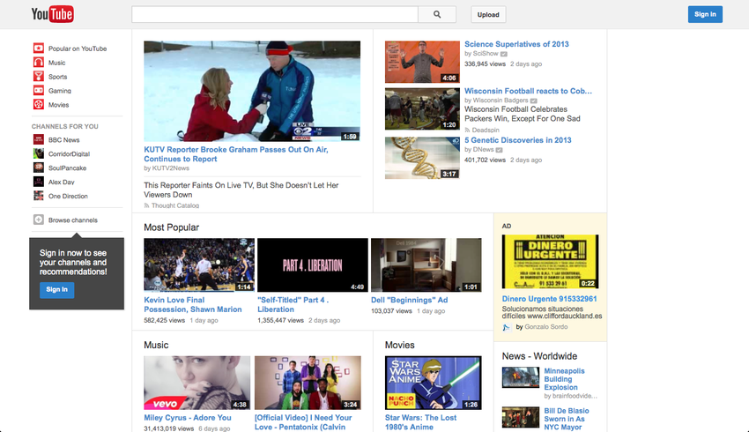

Application of AI

Slide 6
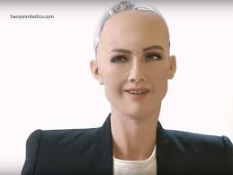
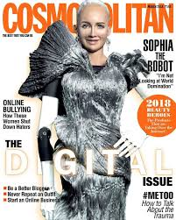
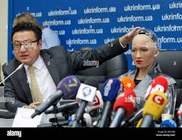
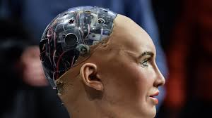
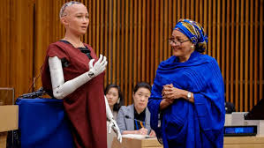
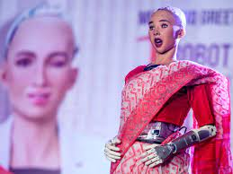
AI in Robotics

Slide 7

Our Aims
Solving campus and nation wide challenges
Building a team of competent programmers
Building a strong relationship during and after campus
Turing the trend of life of Ugandans
Advertising the University
Giving the northern region a new brand name

Slide 8

Our time schedule
Thursday and Friday
6pm to 8pm
Trainings : strictly HandsOn

Slide 9
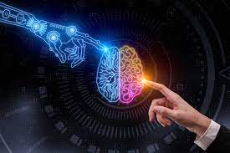
OUR MENTORS
Lukenge Benard
Laya Godfrey Clement
Kisekka Ignatius
Wekobsya Samuel
Nyanzi Matia

Slide 10


Slide 11
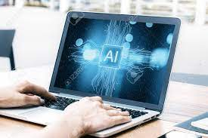
Lets meet tomorrow !!!!! Attend with your laptop Data analysis ( we shall write a program to help finalists analyze their research dataset in just 2 seconds)

